Slide 1

236781
Lecture 8
Deep learning
Attention models
Dr. Chaim Baskin

Slide 2
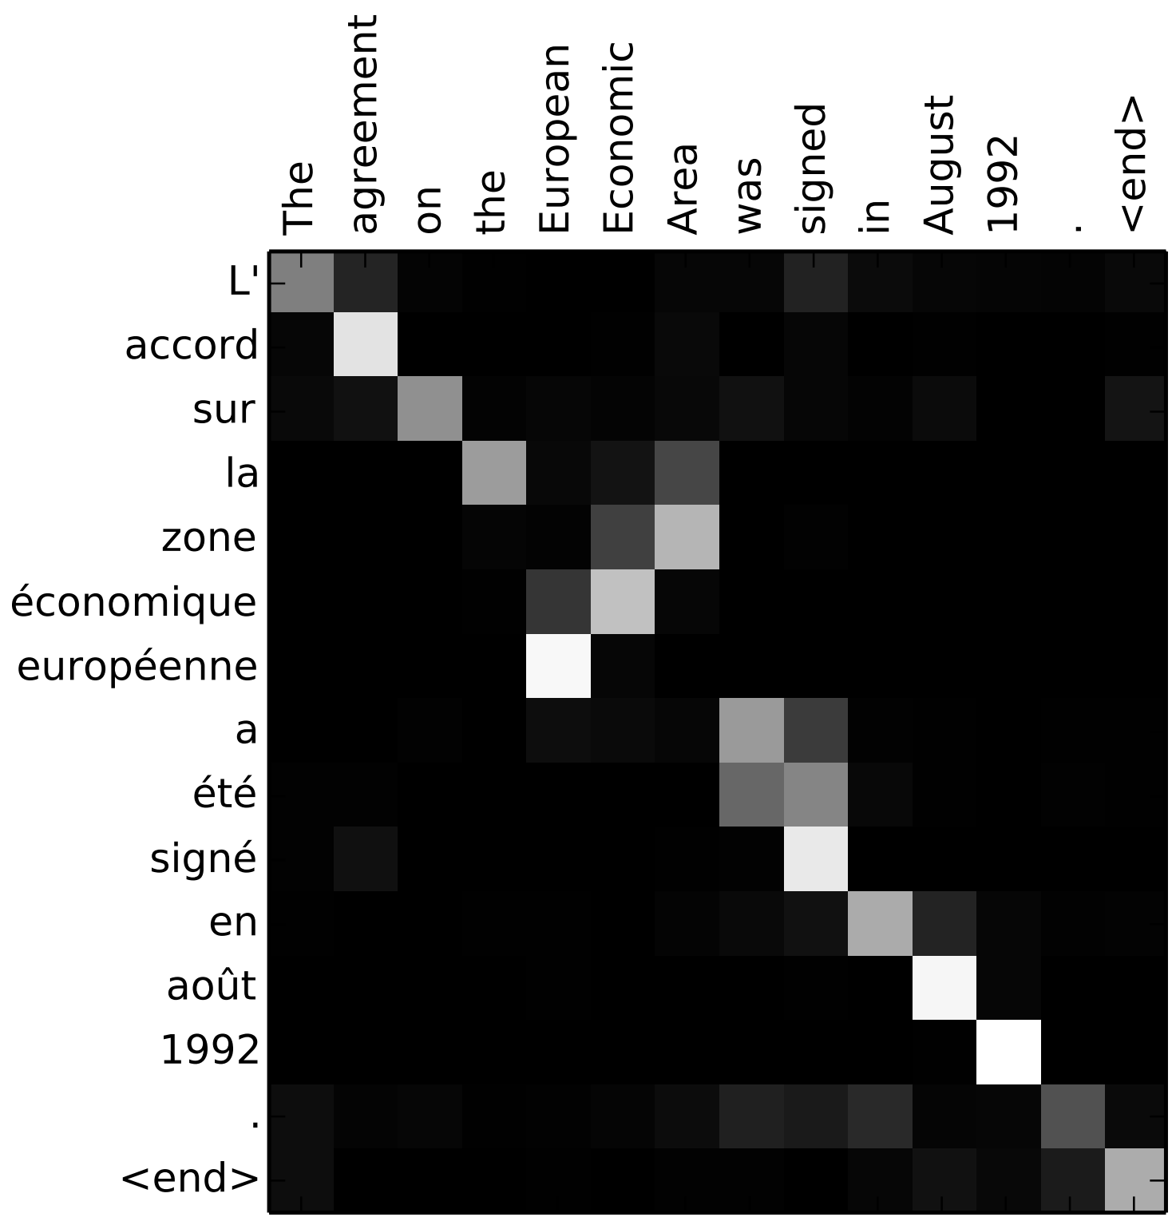
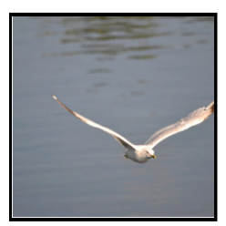
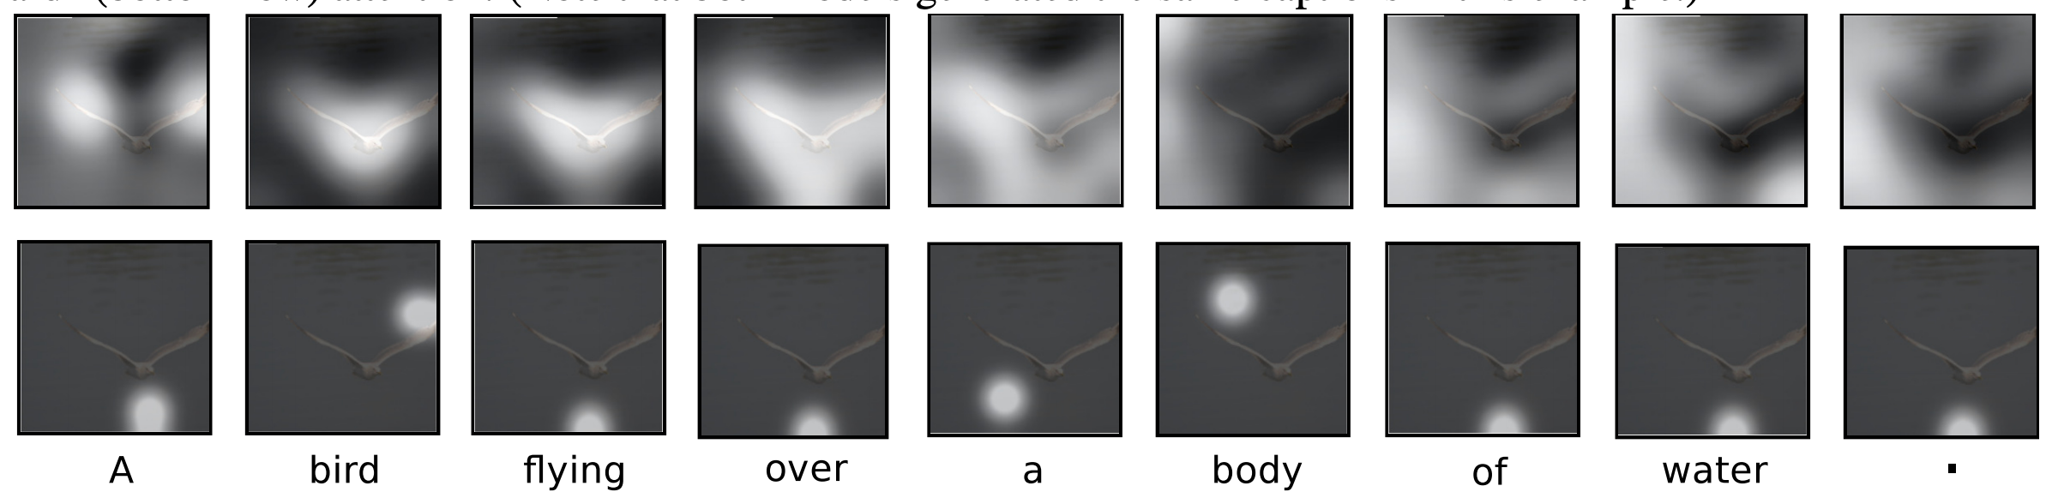
Sequence-to-sequence models with attention
Many slides adapted from J. Johnson

Slide 3
Outline
Vanilla seq2seq with RNNs
Seq2seq with RNNs and attention
Image captioning with attention
Transformers

Slide 4
Sequence-to-sequence modeling: Machine translation
“We are eating bread”
“Estamos comiendo pan”

Slide 5
Sequence-to-sequence modeling with RNNs
I. Sutskever, O. Vinyals, Q. Le, Sequence to Sequence Learning with Neural Networks, NeurIPS 2014
K. Cho, B. Merrienboer, C. Gulcehre, F. Bougares, H. Schwenk, and Y. Bengio, Learning phrase representations using RNN encoder-decoder for statistical machine translation, ACL 2014

Slide 6
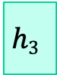
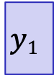
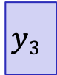
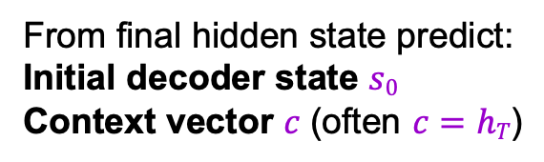
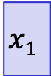
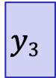
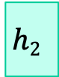
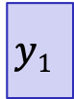

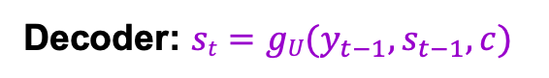
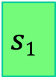
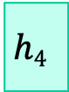
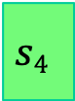
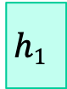
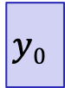
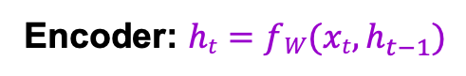
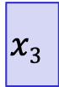
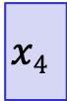

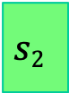

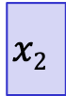
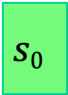

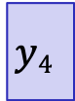
Sequence-to-sequence modeling with RNNs
Decoder: $st=gU(y_{t−1},s_{t−1}, c)$
estamos
comiendo
pan
[STOP]
From final hidden state predict:
Initial decoder state $s0$
Context vector $c$ (often $c=hT$)
$$y1$$
$$y2$$
$$y3$$
$$y4$$
Encoder: $ht=fW(xt,h_{t−1})$
$$h1$$
$$h2$$
$$h3$$
$$h4$$
$$s0$$
$$s1$$
$$s2$$
$$s3$$
$$s4$$
$$x1$$
$$x2$$
$$x3$$
$$x4$$
$$c$$
$$y0$$
$$y1$$
$$y2$$
$$y3$$
we
are
eating
bread
[START]
estamos
comiendo
pan

Slide 7
Sequence-to-sequence modeling with RNNs
Decoder: $st=gU(y_{t−1},s_{t−1}, c)$
estamos
comiendo
pan
[STOP]
From final hidden state predict:
Initial decoder state $s0$
Context vector $c$ (often $c=hT$)
$$y1$$
$$y2$$
$$y3$$
$$y4$$
Encoder: $ht=fW(xt,h_{t−1})$
$$h1$$
$$h2$$
$$h3$$
$$h4$$
$$s0$$
$$s1$$
$$s2$$
$$s3$$
$$s4$$
$$x1$$
$$x2$$
$$x3$$
$$x4$$
$$c$$
$$y0$$
$$y1$$
$$y2$$
$$y3$$
we
are
eating
bread
[START]
estamos
comiendo
pan
Problem: Input sequence bottlenecked through fixed-sized vector
Idea: use new context vector at each step of decoder!

Slide 8
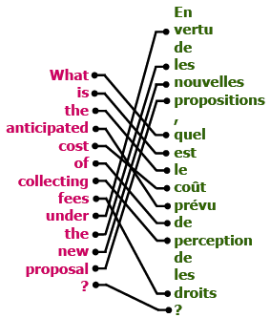
Sequence-to-sequence with RNNs and attention
Intuition: translation requires alignment

Slide 9
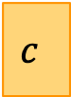
Sequence-to-sequence with RNNs and attention
At each timestep of decoder, context vector “looks at” different parts of the input sequence
$$h1$$
$$h2$$
$$h3$$
$$h4$$
$$s0$$
$$x1$$
$$x2$$
$$x3$$
$$x4$$
$$c$$
we
are
eating
bread

Slide 10
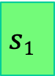
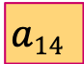
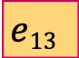
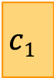
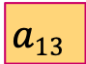
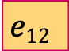
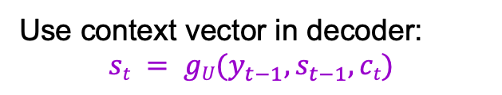
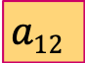
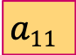
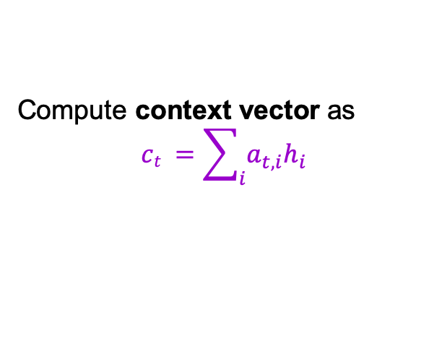
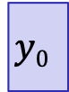
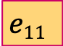
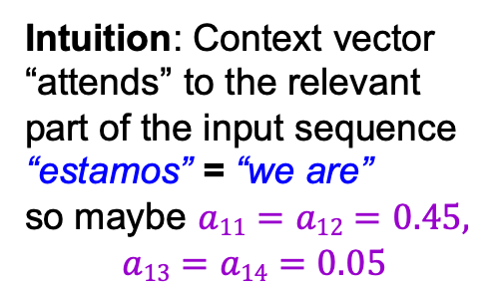
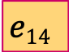
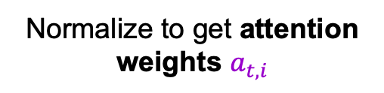
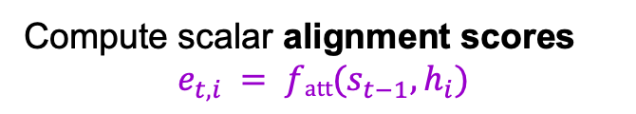
Sequence-to-sequence with RNNs and attention
+
✖️
✖️
✖️
Compute context vector as
$$ct =\sum_{i}{a_{t,i}h_{i}}$$
✖️
Normalize to get attention weights $a_{t,i}$
$$a11$$
$$a12$$
$$a13$$
$$a14$$
estamos
softmax
$$y1$$
Compute scalar alignment scores
$$e_{t,i} = fatt(s_{t−1}, h_{i})$$
$$e11$$
$$e12$$
$$e13$$
$$e14$$
$$h1$$
$$h2$$
$$h3$$
$$h4$$
$$s0$$
$$s1$$
Use context vector in decoder:
$$st = gU(y_{t−1}, s_{t−1}, ct)$$
Intuition: Context vector “attends” to the relevant part of the input sequence
“estamos” = “we are”
so maybe $a11=a12=0.45,$
$$a13=a14=0.05$$
$$x1$$
$$x2$$
$$x3$$
$$x4$$
$$c1$$
$$y0$$
we
are
eating
bread
[START]
D. Bahdanau, K. Cho, Y. Bengio, Neural Machine Translation by Jointly Learning to Align and Translate, ICLR 2015

Slide 11
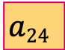

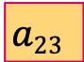

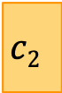
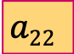
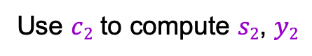
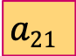
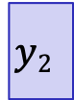
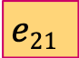




Sequence-to-sequence with RNNs and attention
+
✖️
✖️
✖️
✖️
$$a21$$
$$a22$$
$$a23$$
$$a24$$
estamos
comiendo
softmax
$$y1$$
$$y2$$
$$e21$$
$$e22$$
$$e23$$
$$e24$$
$$h1$$
$$h2$$
$$h3$$
$$h4$$
$$s0$$
$$s1$$
$$s2$$
Use $c2$ to compute $s2$, $y2$
Repeat: Use $s1$ to compute new context vector $c2$
$$x1$$
$$x2$$
$$x3$$
$$x4$$
$$c1$$
$$y0$$
$$c2$$
$$y1$$
we
are
eating
bread
[START]
estamos

Slide 12











Sequence-to-sequence with RNNs and attention
+
✖️
✖️
✖️
✖️
$$a31$$
$$a32$$
$$a33$$
$$a34$$
estamos
comiendo
pan
softmax
$$y1$$
$$y2$$
$$y3$$
$$e31$$
$$e32$$
$$e33$$
$$e34$$
$$h1$$
$$h2$$
$$h3$$
$$h4$$
$$s0$$
$$s1$$
$$s2$$
$$s3$$
$$x1$$
$$x2$$
$$x3$$
$$x4$$
$$c1$$
$$y0$$
$$c2$$
$$y1$$
$$c3$$
$$y2$$
we
are
eating
bread
[START]
estamos
comiendo

Slide 13












Sequence-to-sequence with RNNs and attention
+
✖️
✖️
✖️
✖️
$$a41$$
$$a42$$
$$a43$$
$$a44$$
estamos
comiendo
pan
[STOP]
softmax
$$y1$$
$$y2$$
$$y3$$
$$y4$$
$$e41$$
$$e42$$
$$e43$$
$$e44$$
$$h1$$
$$h2$$
$$h3$$
$$h4$$
$$s0$$
$$s1$$
$$s2$$
$$s3$$
$$s4$$
$$x1$$
$$x2$$
$$x3$$
$$x4$$
$$c1$$
$$y0$$
$$c2$$
$$y1$$
$$c3$$
$$y2$$
$$c4$$
$$y3$$
we
are
eating
bread
[START]
estamos
comiendo
pan

Slide 14








Sequence-to-sequence with RNNs and attention
+
✖️
✖️
✖️
✖️
$$at1$$
$$at2$$
$$at3$$
$$at4$$
estamos
comiendo
pan
[STOP]
softmax
$$y1$$
$$y2$$
$$y3$$
$$y4$$
$$et1$$
$$et2$$
$$et3$$
$$et4$$
$$h1$$
$$h2$$
$$h3$$
$$h4$$
$$s0$$
$$s1$$
$$s2$$
$$s3$$
$$s4$$
$$x1$$
$$x2$$
$$x3$$
$$x4$$
$$c1$$
$$y0$$
$$c2$$
$$y1$$
$$c3$$
$$y2$$
$$c4$$
$$y3$$
we
are
eating
bread
[START]
estamos
comiendo
pan

Slide 15
Sequence-to-sequence with RNNs and attention
Visualizing attention weights (English source, French target):
Same word order in source and target languages
Flipped word order
Verb conjugation is different
D. Bahdanau, K. Cho, Y. Bengio, Neural Machine Translation by Jointly Learning to Align and Translate, ICLR 2015
Notes:
The x-axis and y-axis of each plot correspond to the words in the source sentence (English) and the generated translation (French), respectively. Each pixel shows the weight αij of the annotation of the j-th source word for the i-th target word

Slide 16
Quantitative evaluation
With attention
(trained with sentence length <= 50)
With attention
(trained with sentence length <= 30)
No attention
D. Bahdanau, K. Cho, Y. Bengio, Neural Machine Translation by Jointly Learning to Align and Translate, ICLR 2015

Slide 17
BLEU: Bilingual Evaluation Understudy
N-gram precision: count the number of n-gram matches between candidate and reference translation, divide by total number of n-grams in candidate translation
Clip counts by the maximum number of times an n-gram occurs in any reference translation
Multiply by brevity penalty to penalize short translations
Most commonly used measure for machine translation and image captioning despite multiple shortcomings
K. Papineni, S. Roukos, T. Ward, W.-J. Zhu, BLEU: a Method for Automatic Evaluation of Machine Translation, ACL 2002
Notes:
Purpose of clipping: “MT systems can overgenerate “reasonable” words, resulting in improbable, but high-precision, translations. Intuitively the problem is clear: a reference word should be considered exhausted after a matching candidate word is identified.”

Slide 18

BLEU: Bilingual Evaluation Understudy
https://towardsdatascience.com/evaluating-text-output-in-nlp-bleu-at-your-own-risk-e8609665a213
Notes:
Purpose of clipping: “MT systems can overgenerate “reasonable” words, resulting in improbable, but high-precision, translations. Intuitively the problem is clear: a reference word should be considered exhausted after a matching candidate word is identified.”

Slide 19

Google Neural Machine Translation (GNMT)
Y. Wu et al., Google's Neural Machine Translation System: Bridging the Gap between Human and Machine Translation, arXiv 2016
https://www.nytimes.com/2016/12/14/magazine/the-great-ai-awakening.html

Slide 20

Google Neural Machine Translation (GNMT)
Y. Wu et al., Google's Neural Machine Translation System: Bridging the Gap between Human and Machine Translation, arXiv 2016
Notes:
The model architecture of GNMT, Google’s Neural Machine Translation system. On the left is the encoder network, on the right is the decoder network, in the middle is the attention module. The bottom encoder layer is bi-directional: the pink nodes gather information from left to right while the green nodes gather information from right to left. The other layers of the encoder are uni-directional. Residual connections start from the layer third from the bottom in the encoder and decoder. The model is partitioned into multiple GPUs to speed up training. In our setup, we have 8 encoder LSTM layers (1 bi-directional layer and 7 uni-directional layers), and 8 decoder layers. With this setting, one model replica is partitioned 8-ways and is placed on 8 different GPUs typically belonging to one host machine. During training, the bottom bi-directional encoder layers compute in parallel first. Once both finish, the uni-directional encoder layers can start computing, each on a separate GPU. To retain as much parallelism as possible during running the decoder layers, we use the bottom decoder layer output only for obtaining recurrent attention context, which is sent directly to all the remaining decoder layers. The softmax layer is also partitioned and placed on multiple GPUs. Depending on the output vocabulary size we either have them run on the same GPUs as the encoder and decoder networks, or have them run on a separate set of dedicated GPUs.

Slide 21

Google Neural Machine Translation (GNMT)
Standard training objective: maximize log-likelihood of ground truth output given input:
$$\sum_{i}{\log{ P_{W}\left(Y_{i}^{∗} | X_{i}\right)}}$$
Only encourages the system to reproduce the reference sentences, does not induce a very good ranking on outputs that don’t match reference sentences
Not related to task-specific evaluation metric (e.g., BLEU score)
Refinement objective: expectation of rewards over possible predicted sentences $Y$:
$$\sum_{i}{\sum_{Y}{P_{W}\left(Y | X_{i}\right) R(Y,Y_{i}^{∗})}}$$
Use variant of BLEU score to compute reward
Reward is not differentiable -- need RL to train (initialize with ML-trained model)

Slide 22

Google Neural Machine Translation (GNMT)
Human evaluation results on production data (500 randomly sampled sentences from Wikipedia and news websites)
Side-by-side scores: range from 0 (“completely nonsense translation”) to 6 (“perfect translation”), produced by human raters fluent in both languages
PBMT: Translation by phrase-based statistical translation system used by Google
GNMT: Translation by GNMT system
Human: Translation by humans fluent in both languages

Slide 23
Outline
Vanilla seq2seq with RNNs
Seq2seq with RNNs and attention
Image captioning with attention

Slide 24


Generalizing attention
+
✖️
✖️
✖️
✖️
$$ct =\sum_{i}{a_{t,i}h_{i}}$$
$$at1$$
$$at2$$
$$at3$$
$$at4$$
estamos
comiendo
pan
[STOP]
softmax
$$y1$$
$$y2$$
$$y3$$
$$y4$$
$$et1$$
$$et2$$
$$et3$$
$$et4$$
The decoder doesn’t use the fact that the $hi$ form an ordered sequence – it just treats them as an unordered set
Can use similar architecture given any set of input hidden vectors $\{h_{i}\}$!
$$h1$$
$$h2$$
$$h3$$
$$h4$$
$$s0$$
$$s1$$
$$s2$$
$$s3$$
$$s4$$
$$x1$$
$$x2$$
$$x3$$
$$x4$$
$$c1$$
$$y0$$
$$c2$$
$$y1$$
$$c3$$
$$y2$$
$$c4$$
$$y3$$
we
are
eating
bread
[START]
estamos
comiendo
pan

Slide 25
Image captioning with RNNs and attention
Idea: pay attention to different parts of the image when generating different words
Automatically learn this grounding of words to image regions without direct supervision
K. Xu et al., Show, Attend and Tell: Neural Image Caption Generation with Visual Attention, ICML 2015

Slide 26






Image captioning with RNNs and attention
Alignment scores
Attention weights
$$e_{1,1,1}$$ | $$e_{1,1,2}$$ | $$e_{1,1,3}$$
$$e_{1,2,1}$$ | $$e_{1,2,2}$$ | $$e_{1,2,3}$$
$$e_{1,3,1}$$ | $$e_{1,3,2}$$ | $$e_{1,3,3}$$
$$a_{1,1,1}$$ | $$a_{1,1,2}$$ | $$a_{1,1,3}$$
$$a_{1,2,1}$$ | $$a_{1,2,2}$$ | $$a_{1,2,3}$$
$$a_{1,3,1}$$ | $$a_{1,3,2}$$ | $$a_{1,3,3}$$
$$e_{t,i,j} = fatt(s_{t−1},h_{i,j})$$
softmax
$$h_{1,1}$$ | $$h_{1,2}$$ | $$h_{1,3}$$
$$h_{2,1}$$ | $$h_{2,2}$$ | $$h_{2,3}$$
$$h_{3,1}$$ | $$h_{3,2}$$ | $$h_{3,3}$$
CNN
$$s0$$
Use CNN to extract a grid of features
K. Xu et al., Show, Attend and Tell: Neural Image Caption Generation with Visual Attention, ICML 2015

Slide 27


Image captioning with RNNs and attention
Alignment scores
Attention weights
$$e_{1,1,1}$$ | $$e_{1,1,2}$$ | $$e_{1,1,3}$$
$$e_{1,2,1}$$ | $$e_{1,2,2}$$ | $$e_{1,2,3}$$
$$e_{1,3,1}$$ | $$e_{1,3,2}$$ | $$e_{1,3,3}$$
$$a_{1,1,1}$$ | $$a_{1,1,2}$$ | $$a_{1,1,3}$$
$$a_{1,2,1}$$ | $$a_{1,2,2}$$ | $$a_{1,2,3}$$
$$a_{1,3,1}$$ | $$a_{1,3,2}$$ | $$a_{1,3,3}$$
$$e_{t,i,j} = fatt(s_{t−1},h_{i,j})$$
softmax
cat
$$y1$$
$$h_{1,1}$$ | $$h_{1,2}$$ | $$h_{1,3}$$
$$h_{2,1}$$ | $$h_{2,2}$$ | $$h_{2,3}$$
$$h_{3,1}$$ | $$h_{3,2}$$ | $$h_{3,3}$$
CNN
$$s0$$
$$s1$$
$$c1$$
$$y0$$
$$ct =\sum_{i}{a_{t,i,j}h_{i}}$$
[START]

Slide 28



Image captioning with RNNs and attention
Alignment scores
Attention weights
$$e_{2,1,1}$$ | $$e_{2,1,2}$$ | $$e_{2,1,3}$$
$$e_{2,2,1}$$ | $$e_{2,2,2}$$ | $$e_{2,2,3}$$
$$e_{2,3,1}$$ | $$e_{2,3,2}$$ | $$e_{2,3,3}$$
$$a_{2,1,1}$$ | $$a_{2,1,2}$$ | $$a_{2,1,3}$$
$$a_{2,2,1}$$ | $$a_{2,2,2}$$ | $$a_{2,2,3}$$
$$a_{2,3,1}$$ | $$a_{2,3,2}$$ | $$a_{2,3,3}$$
$$e_{t,i,j} = fatt(s_{t−1},h_{i,j})$$
softmax
cat
sitting
$$y1$$
$$y2$$
$$h_{1,1}$$ | $$h_{1,2}$$ | $$h_{1,3}$$
$$h_{2,1}$$ | $$h_{2,2}$$ | $$h_{2,3}$$
$$h_{3,1}$$ | $$h_{3,2}$$ | $$h_{3,3}$$
CNN
$$s0$$
$$s1$$
$$s2$$
Use a CNN to compute a grid of features for an image
$$c1$$
$$y0$$
$$c2$$
$$y1$$
$$ct =\sum_{i}{a_{t,i,j}h_{i}}$$
[START]
cat

Slide 29



Image captioning with RNNs and attention
Alignment scores
Attention weights
$$e_{t,1,1}$$ | $$e_{t,1,2}$$ | $$e_{t,1,3}$$
$$e_{t,2,1}$$ | $$e_{t,2,2}$$ | $$e_{t,2,3}$$
$$e_{t,3,1}$$ | $$e_{t,3,2}$$ | $$e_{t,3,3}$$
$$a_{t,1,1}$$ | $$a_{t,1,2}$$ | $$a_{t,1,3}$$
$$a_{t,2,1}$$ | $$a_{t,2,2}$$ | $$a_{t,2,3}$$
$$a_{t,3,1}$$ | $$a_{t,3,2}$$ | $$a_{t,3,3}$$
$$e_{t,i,j} = fatt(s_{t−1},h_{i,j})$$
softmax
cat
sitting
outside
[STOP]
$$y1$$
$$y2$$
$$y3$$
$$y4$$
$$h_{1,1}$$ | $$h_{1,2}$$ | $$h_{1,3}$$
$$h_{2,1}$$ | $$h_{2,2}$$ | $$h_{2,3}$$
$$h_{3,1}$$ | $$h_{3,2}$$ | $$h_{3,3}$$
CNN
$$s0$$
$$s1$$
$$s2$$
$$s3$$
$$s4$$
$$c1$$
$$y0$$
$$c2$$
$$y1$$
$$c3$$
$$y2$$
$$c4$$
$$y3$$
$$ct =\sum_{i}{a_{t,i,j}h_{i}}$$
[START]
cat
sitting
outside
Each time step of decoder uses a different context vector that looks at different parts of the input image

Slide 30

Example results
Good captions

Slide 31

Example results
Mistakes

Slide 32

Quantitative results
Source

Slide 33
X, Attend, and Y
“Show, attend, and tell” (Xu et al, ICML 2015)
Look at image, attend to image regions, produce question
“Ask, attend, and answer” (Xu and Saenko, ECCV 2016)
“Show, ask, attend, and answer” (Kazemi and Elqursh, 2017)
Read text of question, attend to image regions, produce answer
“Listen, attend, and spell” (Chan et al, ICASSP 2016)
Process raw audio, attend to audio regions while producing text
“Listen, attend, and walk” (Mei et al, AAAI 2016)
Process text, attend to text regions, output navigation commands
“Show, attend, and interact” (Qureshi et al, ICRA 2017)
Process image, attend to image regions, output robot control commands
“Show, attend, and read” (Li et al, AAAI 2019)
Process image, attend to image regions, output text
Source: J. Johnson

Slide 34
Outline
Vanilla seq2seq with RNNs
Seq2seq with RNNs and attention
Image captioning with attention
Transformers

Slide 35
Sequence modeling beyond RNNs
RNNs
1D convolutional networks
Transformers
h₁
h₂
h₃
h₄
h₁
h₂
h₃
h₄
x₁
x₂
x₃
x₄
x₁
x₂
x₃
x₄
Works on ordered sequences
Pros: Not limited by fixed context size (in principle): After one RNN layer, h_{T} ”sees” the whole sequence
Con: Hidden states have limited expressive capacity
Con: Not parallelizable: need to compute hidden states sequentially
Works on multidimensional grids
Pro: Each output can be computed in parallel (at training time)
Con: Bad at long sequences: Need to stack many conv layers for outputs to “see” the whole sequence
Works on sets of vectors

Slide 36
Basic transformer model
Sequence-to-sequence architecture using only point-wise processing and attention – no recurrent units or convolutions
Encoder: receives entire input sequence and outputs encoded sequence of the same length
Decoder: predicts next token conditioned on encoder output and previously predicted tokens
A. Vaswani, N. Shazeer, N. Parmar, J. Uszkoreit, L. Jones, A. Gomez, L. Kaiser, I. Polosukhin, Attention is all you need, NeurIPS 2017
Image source

Slide 37

Key-Value-Query attention model
Decoder
The decoder generates a query describing what it wants to focus on
$$Y1$$
$$Y2$$
$Y$₃
$Y$₄
Sum the values generated by encoder weighted by the attention weights
Feed the scores into a softmax to create the attention weights
Compute dot products between the query and the keys generated by encoder, giving alignment scores between source tokens and the query
$$X1$$
$$X2$$
$X$₃
$X$₄
Encoder
Image source

Slide 38
Key-Value-Query attention model
$$Y1$$
$$Y2$$
$$Y3$$
$$Y4$$
Key vectors: $K = XW_{K}$
Value Vectors: $V = XW_{V}$
Query vectors
Similarities: scaled dot-product attention
$E_{i,j} =\frac{\left(Q_{i} · Kj\right)}{\sqrt{D}}$ or $E = QK^{T} /\sqrt{D}$
($D$ is the dimensionality of the keys)
Attn. weights: $A = softmax(E, dim=1)$
Output vectors:
$Y_{i}=\sum_{j}{A_{i,j}V_{j}}$ or $Y = AV$
Product( ), Sum( )
$$V1$$
$$A_{1,1}$$
$$A_{2,1}$$
$$A_{3,1}$$
$$A_{4,1}$$
$$V2$$
$$A_{1,2}$$
$$A_{2,2}$$
$$A_{3,2}$$
$$A_{4,2}$$
$$V3$$
$$A_{1,3}$$
$$A_{2,3}$$
$$A_{3,3}$$
$$A_{4,3}$$
Softmax( )
$$X1$$
$$K1$$
$$E_{1,1}$$
$$E_{2,1}$$
$$E_{3,1}$$
$$E_{4,1}$$
$$X2$$
$$K2$$
$$E_{1,2}$$
$$E_{2,2}$$
$$E_{3,2}$$
$$E_{4,2}$$
$$X3$$
$$K3$$
$$E_{1,3}$$
$$E_{2,3}$$
$$E_{3,3}$$
$$E_{4,3}$$
$$Q1$$
$$Q2$$
$$Q3$$
$$Q4$$
Adapted from J. Johnson

Slide 39
Key-Value-Query attention model
$$Y1$$
$$Y2$$
$$Y3$$
$$Y4$$
How does permuting the order of the queries change the output?
How does changing the order of the keys/values change the output?
Product( ), Sum( )
$$V1$$
$$A_{1,1}$$
$$A_{2,1}$$
$$A_{3,1}$$
$$A_{4,1}$$
$$V2$$
$$A_{1,2}$$
$$A_{2,2}$$
$$A_{3,2}$$
$$A_{4,2}$$
$$V3$$
$$A_{1,3}$$
$$A_{2,3}$$
$$A_{3,3}$$
$$A_{4,3}$$
Softmax( )
$$X1$$
$$K1$$
$$E_{1,1}$$
$$E_{2,1}$$
$$E_{3,1}$$
$$E_{4,1}$$
$$X2$$
$$K2$$
$$E_{1,2}$$
$$E_{2,2}$$
$$E_{3,2}$$
$$E_{4,2}$$
$$X3$$
$$K3$$
$$E_{1,3}$$
$$E_{2,3}$$
$$E_{3,3}$$
$$E_{4,3}$$
$$Q1$$
$$Q2$$
$$Q3$$
$$Q4$$
Adapted from J. Johnson

Slide 40
Attention mechanisms
Encoder self-attention: queries, keys, and values come from previous layer of encoder
Decoder self-attention: values corresponding to future decoder outputs are masked out
Encoder-decoder attention: queries come from previous decoder layer, keys and values come from output of encoder

Slide 41
Self-attention
Used to capture context within the sequence
As we are encoding “it”, we should focus on “the animal”
As we are encoding “it”, we should focus on “the street”
Image source

Slide 42
Self-attention layer
$$Y1$$
$$Y2$$
$$Y3$$
Query vectors: $Q= XW_{Q}$
Key vectors: $K = XW_{K}$
Value vectors: $V = XW_{V}$
Similarities: scaled dot-product attention
$E_{i,j} =\frac{\left(Q_{i}· Kj\right)}{\sqrt{D}}$ or $E = QK^{T} /\sqrt{D}$
($D$ is the dimensionality of the keys)
Attn. weights: $A = softmax(E, dim=1)$
Output vectors:
$Y_{i}=\sum_{j}{A_{i,j}V_{j}}$ or $Y = AV$
Product(→), Sum(↑)
$$V3$$
$$A_{1,3}$$
$$A_{2,3}$$
$$A_{3,3}$$
$$V2$$
$$A_{1,2}$$
$$A_{2,2}$$
$$A_{3,2}$$
$$V1$$
$$A_{1,1}$$
$$A_{2,1}$$
$$A_{3,1}$$
Softmax(↑)
$$K3$$
$$E_{1,3}$$
$$E_{2,3}$$
$$E_{3,3}$$
$$K2$$
$$E_{1,2}$$
$$E_{2,2}$$
$$E_{3,2}$$
$$K1$$
$$E_{1,1}$$
$$E_{2,1}$$
$$E_{3,1}$$
$$Q1$$
$$Q2$$
$$Q3$$
$$X1$$
$$X2$$
$$X3$$
Adapted from J. Johnson
One query per input vector

Slide 43

Recall: Self-attention GAN
Queries
Keys
$$s_{ij}={f\left(x_{i}\right)}^{T}g(x_{j})$$
$$β_{j,i}=\frac{exp(s_{ij})}{\sum_{i}{exp(s_{ij})}}$$
How much to attend to location $i$ while synthesizing feature at location $j$
Values
$$o_{j}=v\left(\sum_{i}{β_{j,i}}h\left(x_{i}\right)\right)$$
H. Zhang, I. Goodfellow, D. Metaxas, A. Odena. Self-Attention Generative Adversarial Networks. ICML 2019

Slide 44

Self-attention GAN
Adaptive receptive fields to capture non-local structure
H. Zhang, I. Goodfellow, D. Metaxas, A. Odena. Self-Attention Generative Adversarial Networks. ICML 2019
Notes:
In each row, the first image shows five representative query locations with color coded dots. The other five images are attention maps for those query locations, with corresponding color coded arrows summarizing the most-attended regions. The self-attention module calculates response at a position as a weighted sum of the features at all positions, where the weights – or attention vectors – are calculated with only a small computational cost.
From the abstract: Traditional convolutional GANs generate high-resolution details as a function of only spatially local points in lower-resolution feature maps. In SAGAN, details can be generated using cues from all feature locations. Moreover, the discriminator can check that highly detailed features in distant portions of the image are consistent with each other.

Slide 45
Masked self-attention layer
This
is
….
$$Y1$$
$$Y2$$
$$Y3$$
The decoder should not “look ahead” in the output sequence
Product(→), Sum(↑)
$$V3$$
$$A_{1,3}$$
$$A_{2,3}$$
$$A_{3,3}$$
$$V2$$
$$A_{1,2}$$
$$A_{2,2}$$
$$A_{3,2}$$
$$V1$$
$$A_{1,1}$$
$$A_{2,1}$$
$$A_{3,1}$$
Softmax(↑)
$$K3$$
$$E_{1,3}$$
$$E_{2,3}$$
$$E_{3,3}$$
$$K2$$
$$E_{1,2}$$
$$E_{2,2}$$
$$E_{3,2}$$
$$K1$$
$$E_{1,1}$$
$$E_{2,1}$$
$$E_{3,1}$$
$$Q1$$
$$Q2$$
$$Q3$$
$$X1$$
$$X2$$
$$X3$$
<START>
This
is
Adapted from J. Johnson

Slide 46
Masked self-attention layer
$$Y1$$
$$Y2$$
$$Y3$$
The decoder should not “look ahead” in the output sequence
Product(→), Sum(↑)
$$V3$$
$$A_{1,3}$$
$$A_{2,3}$$
$$A_{3,3}$$
$$V2$$
$$A_{1,2}$$
$$A_{2,2}$$
$$A_{3,2}$$
$$V1$$
$$A_{1,1}$$
$$A_{2,1}$$
$$A_{3,1}$$
Softmax(↑)
$$K3$$
$$E_{1,3}$$
$$E_{2,3}$$
$$E_{3,3}$$
$$K2$$
$$E_{1,2}$$
$$E_{2,2}$$
$$E_{3,2}$$
$$K1$$
$$E_{1,1}$$
$$E_{2,1}$$
$$E_{3,1}$$
$$Q1$$
$$Q2$$
$$Q3$$
$$X1$$
$$X2$$
$$X3$$
Adapted from J. Johnson

Slide 47
Masked self-attention layer
$$Y1$$
$$Y2$$
$$Y3$$
The decoder should not “look ahead” in the output sequence
Product(→), Sum(↑)
$$V3$$
$$0$$
$$0$$
$$A_{3,3}$$
$$V2$$
$$0$$
$$A_{2,2}$$
$$A_{3,2}$$
$$V1$$
$$A_{1,1}$$
$$A_{2,1}$$
$$A_{3,1}$$
Softmax(↑)
$$K3$$
$$−∞$$
$$−∞$$
$$E_{3,3}$$
$$K2$$
$$−∞$$
$$E_{2,2}$$
$$E_{3,2}$$
$$K1$$
$$E_{1,1}$$
$$E_{2,1}$$
$$E_{3,1}$$
$$Q1$$
$$Q2$$
$$Q3$$
$$X1$$
$$X2$$
$$X3$$
Adapted from J. Johnson

Slide 48
Attention mechanisms: Summary
N transformer blocks
N transformer blocks
Encoder self-attention: queries, keys, and values come from the previous layer of the encoder
Decoder self-attention: values corresponding to future decoder outputs are masked out
Encoder-decoder attention: queries come from the previous decoder layer, keys, and values come from the output of the encoder

Slide 49

Attention mechanisms: Illustration
https://ai.googleblog.com/2017/08/transformer-novel-neural-network.html

Slide 50

Transformer architecture: Details
Decoder
Encoder
A. Vaswani et al., Attention is all you need, NeurIPS 2017

Slide 51
Positional encoding
To give transformer information about ordering of tokens, add function of position (based on sines and cosines) to every input
position
Embedding dimension
Image source

Slide 52

Multi-head attention
Run $h$ attention models in parallel on top of different linearly projected versions of $Q, K, V$; concatenate and linearly project the results
Intuition: enables model to attend to different kinds of information at different positions (see visualization tool)
Notes:
“Multi-head attention allows the model to jointly attend to information from different representation subspaces at different positions. With a single attention head, averaging inhibits this.”

Slide 53

Transformer blocks
A Transformer is a sequence of transformer blocks
Vaswani et al.: N=12 blocks, embedding dimension = 512, 6 attention heads
Add & Norm: residual connection followed by layer normalization
Feedforward: two linear layers with ReLUs in between, applied independently to each vector
Attention is the only interaction between inputs!

Slide 54
Transformer block
Layer Normalization:
Given h₁, …, h_{N} (Shape: D)
scale: 𝛾 (Shape: D)
shift: 𝛽 (Shape: D)
𝜇_{i} = (∑_{j} h_{i,j})/D (scalar)
𝜎_{i} = (∑_{j} (h_{i,j} - 𝜇_{i})²/D)^{1/2} (scalar)
z_{i} = (h_{i} - 𝜇_{i}) / 𝜎_{i}
y_{i} = 𝛾 * z_{i} + 𝛽
Ba et al, 2016
Residual connection
MLP independently on each vector
Residual connection
All vectors interact with each other

Slide 55
Transformer architecture: Zooming back out
Decoder
Encoder
A. Vaswani et al., Attention is all you need, NeurIPS 2017

Slide 56
Results
https://ai.googleblog.com/2017/08/transformer-novel-neural-network.html

Slide 57

Different ways of processing sequences

Slide 58
Transformers: Pros and cons
RNNs
1D convolutional networks
Transformers
h₁
h₂
h₃
h₄
h₁
h₂
h₃
h₄
x₁
x₂
x₃
x₄
x₁
x₂
x₃
x₄
Works on ordered sequences
Pros: Not limited by fixed context size (in principle): After one RNN layer, h_{T} ”sees” the whole sequence
Con: Not parallelizable: need to compute hidden states sequentially
Con: Hidden states have limited expressive capacity
Works on multidimensional grids
Pro: Each output can be computed in parallel (at training time)
Con: Need to stack many conv layers for outputs to “see” the whole sequence
Works on sets of vectors
Pro: Good at long sequences: after one self-attention layer, each output “sees” all inputs!
Pro: Each output can be computed in parallel (at training time)
Con: Memory-intensive: cost of attention operator is quadratic in input size

Slide 59

Making transformers more efficient
Y. Tay et al. Efficient transformers: A survey. arXiv 2022

